Slide 1
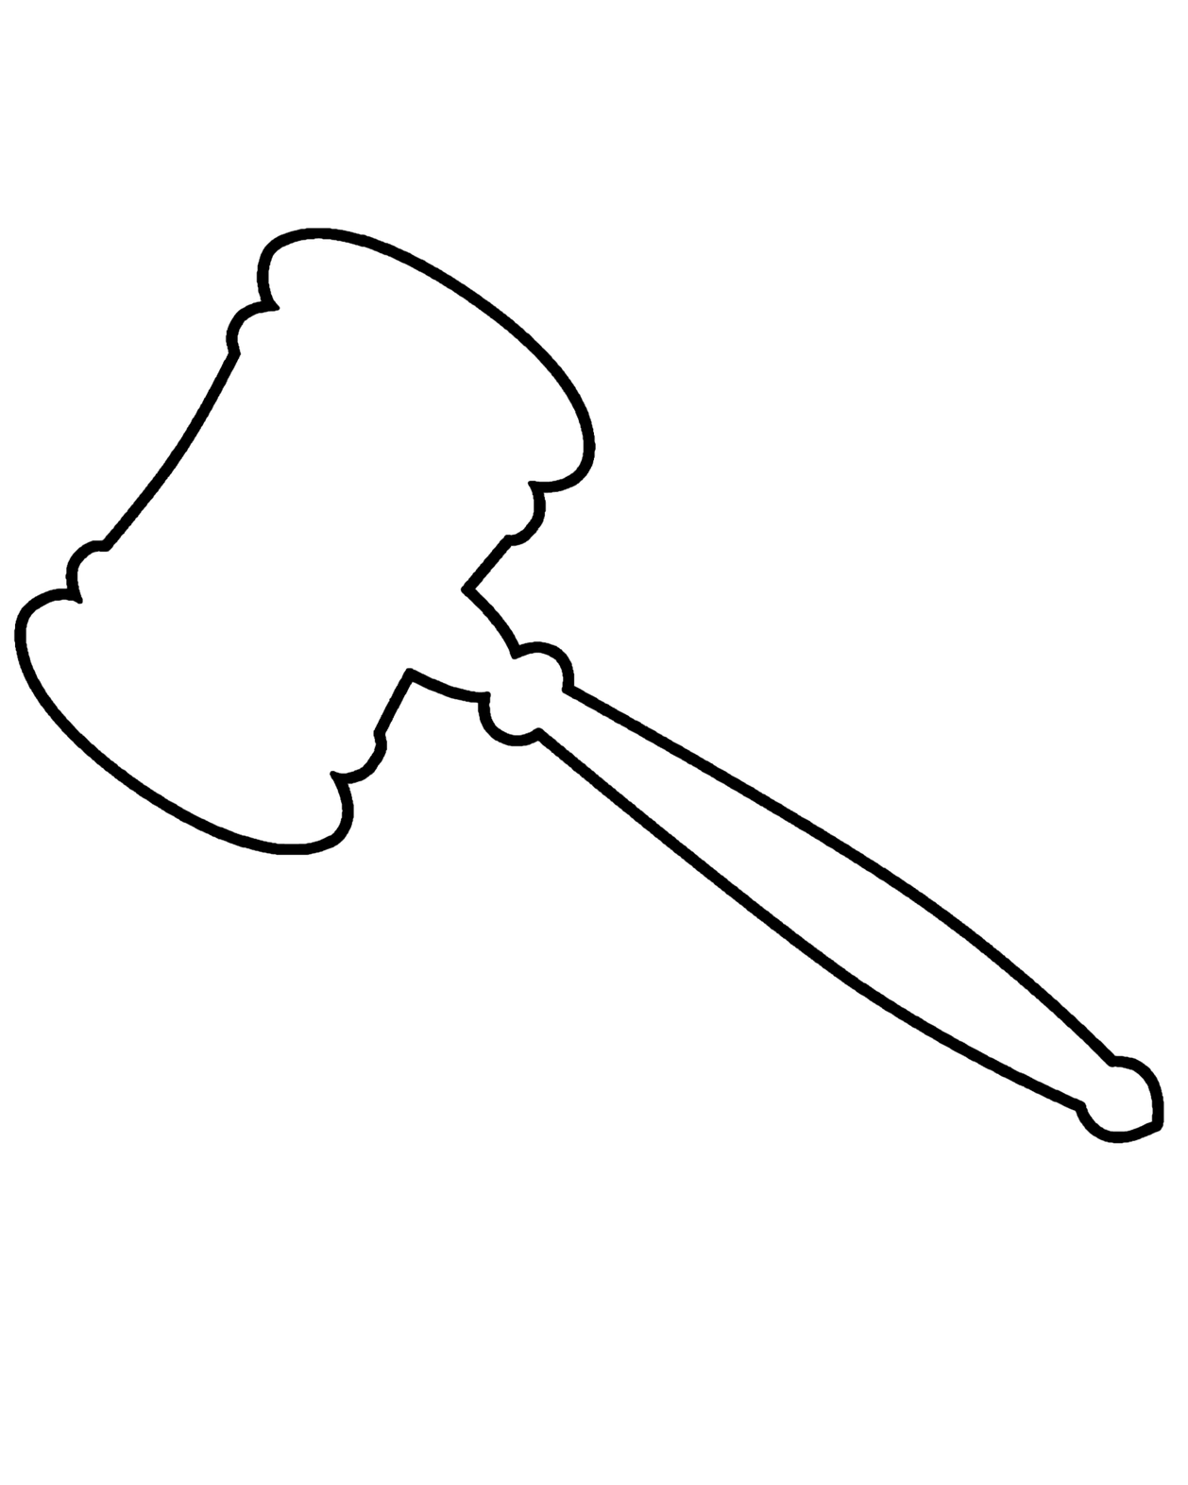
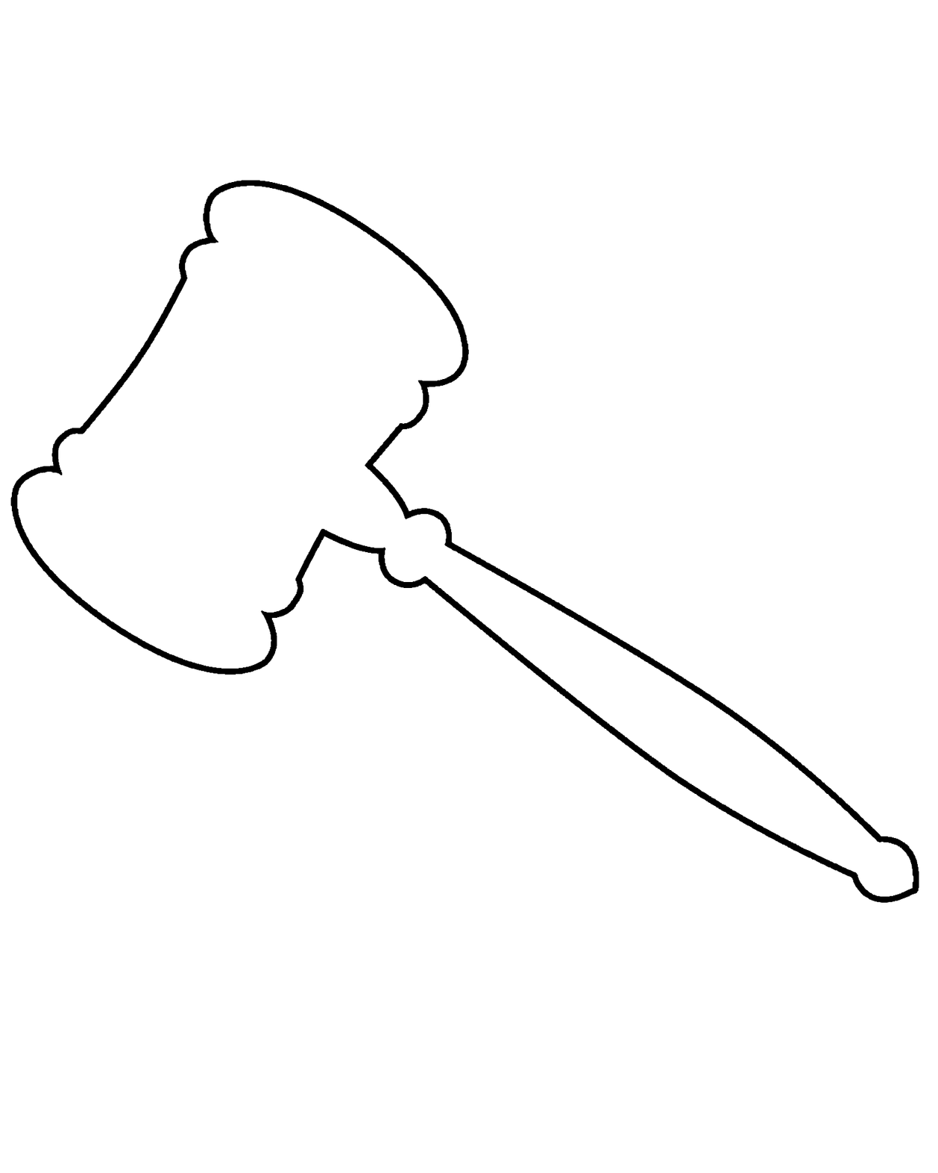
The Ohio Center for Law Related Education | Est. 1983
WE THE PEOPLE
SUMMER INSTITUTE
(USING?) AI IN THE SOCIAL STUDIES CLASSROOM
DATE:
7/07/2026

Slide 2

Session Outline
Map of the Territory
Best Practices
Practical Demos
Questions

Slide 3

What is AI?
01
Understanding what AI is and is not is critical!
A
Artificial Intelligence (AI) is a field of computer science that is dedicated to enabling machines that can perform tasks ordinarily requiring human labor.
B
AI is not a “thinking” brain!
C
Most AI relies on patterns and probabilistic “reasoning” to make predictions.
02
Generative AI is a subset of tools that “creates” new things (images, videos, text, audio, etc.) from pieces in their library of references.
03
There is a wide range of AI tools available, and the quality (as well as price) varies drastically!
04
“You are not a parrot, and AI is not a human!” - Emily Bender
The Ohio Center for Law Related Education

Slide 4

Are you using AI?
01
Personally?
02
In your classroom?
03
With your students?
The Ohio Center for Law Related Education

Slide 5

Best Practices
01
Be aware of AI’s limitations and its mechanics
A
“Hallucination” is the tendency to create nonexistent, false information
B
AI is “trained” on yes/no responses so it seeks validation.
02
GIGO (Garbage In, Garbage Out)
A
Prompt engineering is the practice of crafting a prompt and instructions most likely to yield good results.
B
Models are changing swiftly, so you need to adapt as they grow and change.
The Ohio Center for Law Related Education

Slide 6
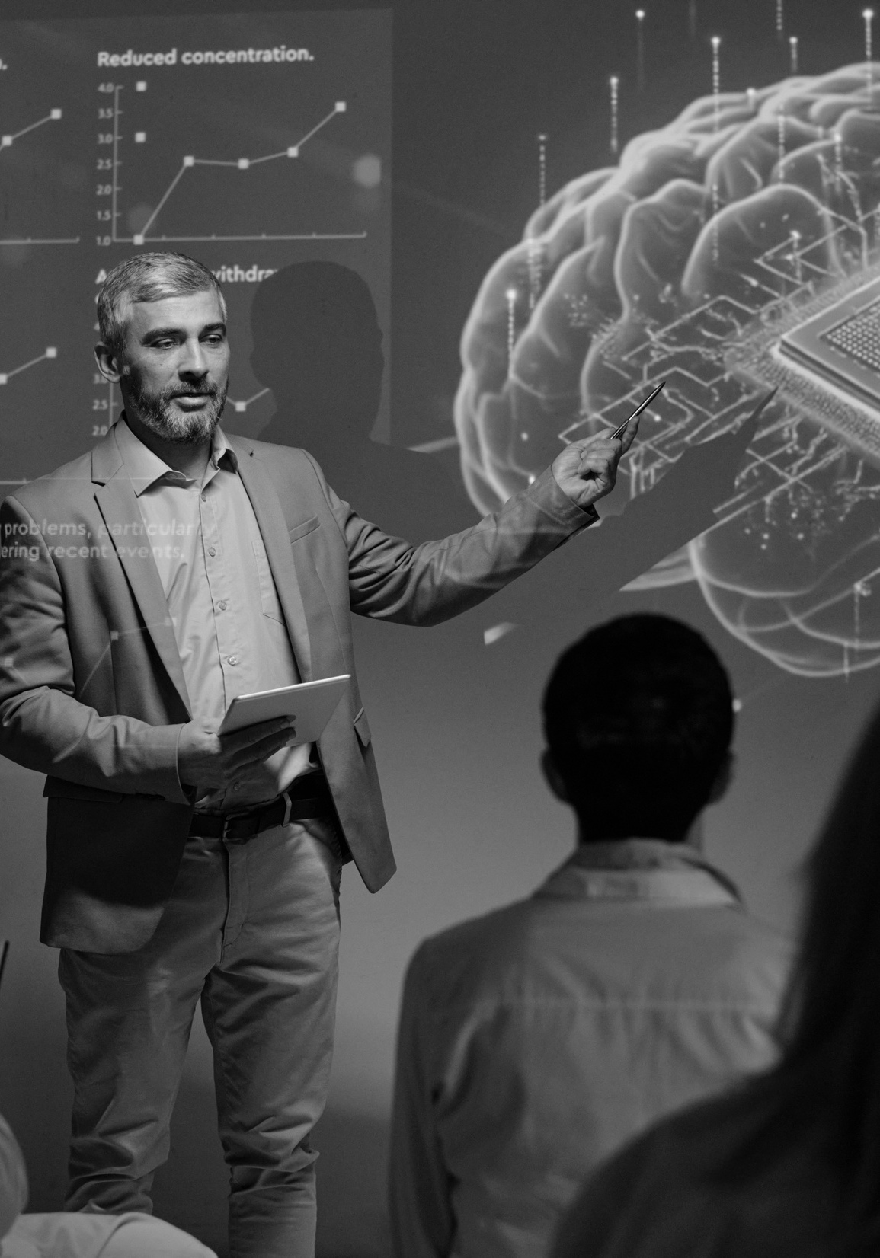
ROLE - TASK - FORMAT
01
Although not essential in newer models, using a well designed Role-Task-Format prompt helps.
A
Role: Give the AI an identity to assume
B
Task: Define the task they will complete
C
Format: Specify the output
EXAMPLE:
Role: You are a high school government teacher with extensive knowledge in the constitution. You are widely read in a range of constitutional scholars like Erwin Chemerinsky and Akhil Amar. You prioritize accessibility and breaking down complex topics for a lay audience with less background knowledge.
Task: Conduct deep research on the opinions released in the October 2025 Term of the United States Supreme Court. Based on the assessment of reputable legal scholars, summarize the majority and dissenting opinions of the most important cases of the term.
Format: Give me a table of contents, a one-paragraph summary for each that includes the vote, the majority summary, and dissent if any. Cite all your work.
The Ohio Center for Law Related Education

Slide 7

Prime - Prompt - Proof
01
AI relies on recency bias and working “memory” to create a product. You can prime the tool.
A
If you don’t put information into its working memory, you run the risk of it using information you don’t want.
B
Starting with a pure conversation about a topic gives the tool a working memory rooted in the topic.
02
Once primed, you can prompt with a well-designed prompt that will draw upon the memory
03
ALWAYS proof the output for accuracy, errors, awkward phrasing.
The Ohio Center for Law Related Education

Slide 8
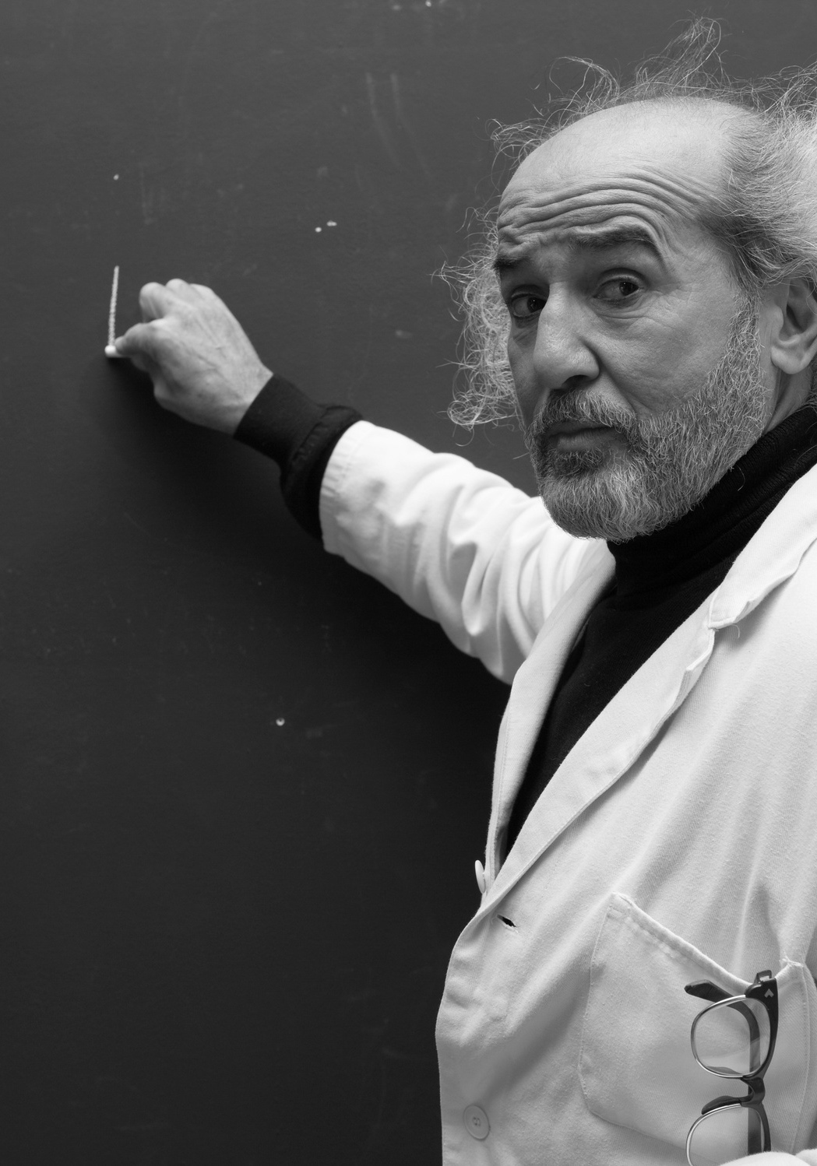
Make Me An Expert
01
Use generative AI chat tools as a teacher to explore topics.
A
Don’t rely on it to produce output, lean on it to create inputs!
Example:
Role: You are an expert in the history of the Philadelphia Convention at which the United States Constitution was drafted. You have read extensively from leading scholars in the field.
Task: Create a detailed list of the most well-known scholarly books on the subject.
Format: For each book give the title, the author, a short synopsis, and the source + rationale you relied on to decide it was “important in the field”
The Ohio Center for Law Related Education

Slide 9
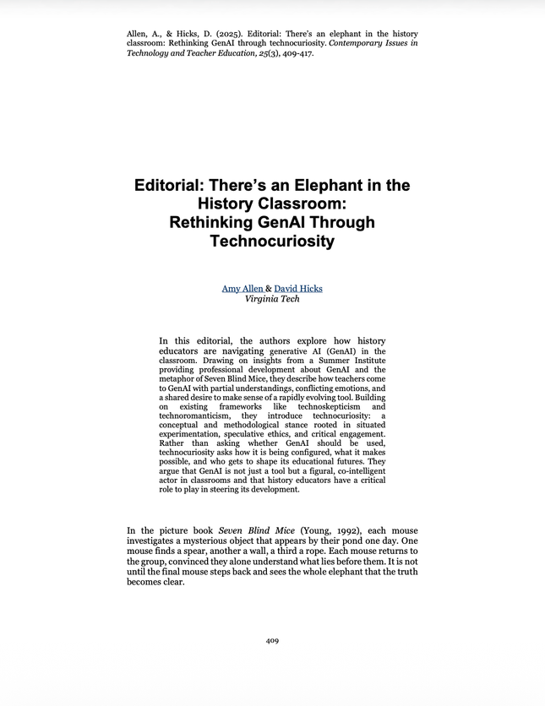
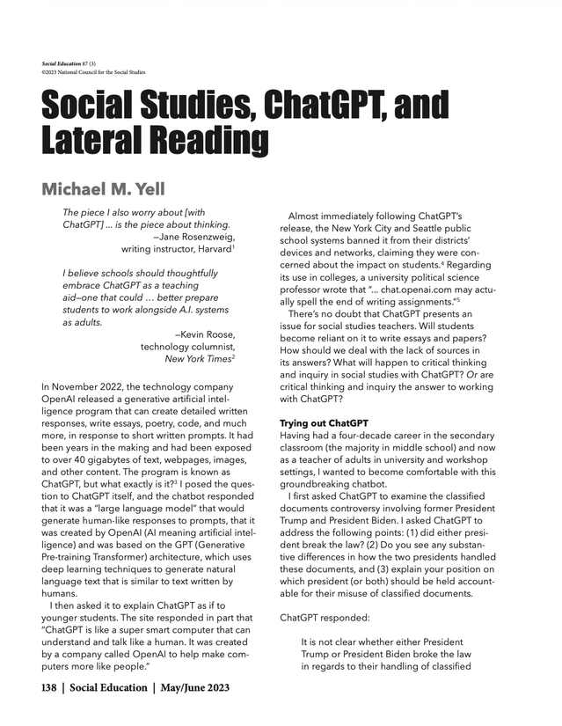
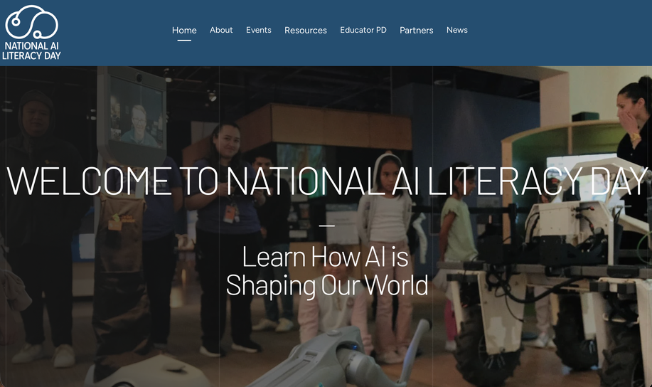
Other Resources
The Ohio Center for Law Related Education

Slide 10

PRACTICAL
DEMO
The Ohio Center for Law Related Education

Slide 11
The Ohio Center for Law Related Education | Est. 1984
Questions?

