Slide 1

The Ohio Center for Law Related Education | Est. 1983
SUPPORTING STUDENTS WITH EXCEPTIONALITIES IN WE THE PEOPLE CLASSROOMS
PRESENTED BY:
DATE:
PROGRAM(S):
Danny Rains
10/22/2025
High School We the People
Middle School We the People

Slide 2

Definition: Students with Exceptionalities
Learners who require specialized instruction and accommodations because they differ from the norm. These students include students with disabilities, English Language Learners, and gifted students.
The Ohio Center for Law Related Education

Slide 3
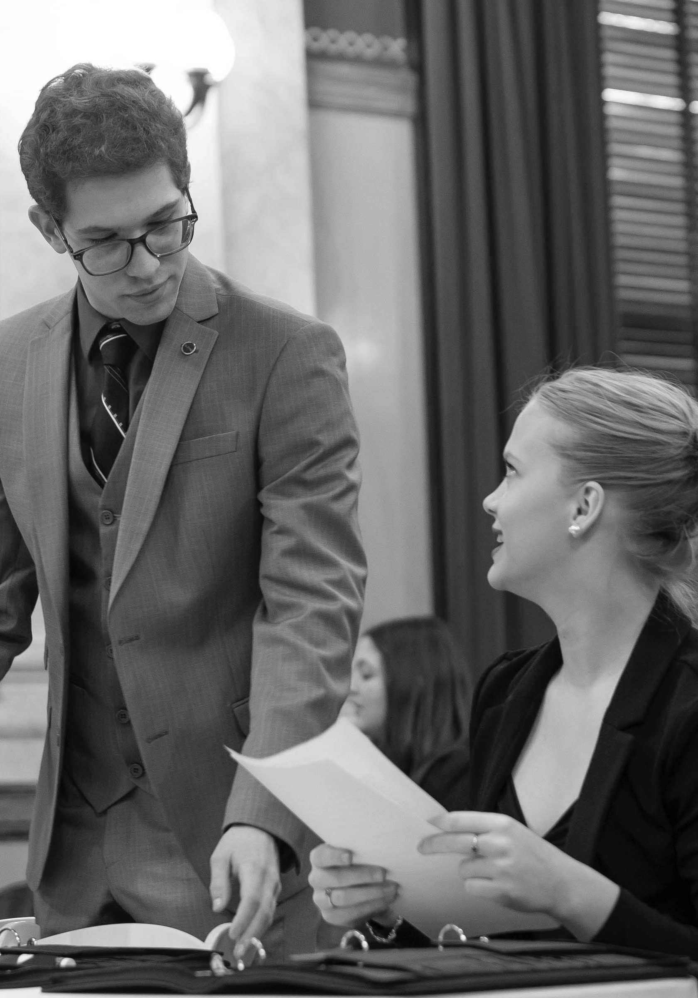
What experience do you have with supporting students with diverse learning needs in your classroom?
What supports does your school have for supporting these students?
The Ohio Center for Law Related Education

Slide 4


Supporting Students with Exceptionalities
Getting to know your students
Planning with them in mind
Curb Cut Effect

Slide 5

Why it’s especially important to get to know these students
01
What are their specific learning needs & accommodations?
02
What are their special interests & strengths?
The Ohio Center for Law Related Education
Notes:
Important background knowledge to have on students: a) are they missing background/cultural knowledge important to the lesson? What are their reading and writing proficiencies? Do they have other challenges, such as interrupted schooling?
Learn about their accommodations and the PURPOSE of those accommodations, especially any that are new to you.
On a start of year survey, ask about what other teachers did that helped them & what they found most challenging last year to get a sense of the struggles & strengths of all students
Finding things students have a connection to & making sure that there are things they feel matter to them help them to learn (gets them invested & interested in material)

Slide 6

Planning With Them In Mind
01
Determining deadlines & due dates
02
Language skills & vocabulary
03
Scaffolding & small group instruction
04
Assessment
The Ohio Center for Law Related Education
Notes:
Keep in mind that it WILL take them longer to do each step of the assignment. Incorporating "work days" allows students to work at their own pace and gives you an opportunity to work with your small groups who need additional support from you.

Slide 7
Supporting Students’ Language Skills
Simplify the Focus Question
Teaching Master Vocabulary
Vocabulary Mapping
How might language in the focus question be challenging?
How can you reword the focus question to keep the idea the same but make it easier to understand?
What language do students need to know MOST to do the work?
Key language uses: In what ways are you asking students to EXPLAIN and ARGUE in the assignment?
Provide context both within and outside of social studies
Include cognates (when possible) and imagery
The Ohio Center for Law Related Education
Notes:
As you're planning your units, think about what language & language skills (explaining and arguing especially) your students need in order to meet the assignment goals. You may need to explicitly teach the language they will use and see in documents and explicitly teach and support structures for those language skills (such as with outlines, graphic organizers, and sentence starters).
When helping students understand new vocabulary, you may need to include on a vocabulary map: word, part of speech, definition, synonyms, other forms (i.e., for "justify" you might include the nouns "justice" and "justification"), example sentences, pictures, and cognates (words that mean and sound the same in both languages) when possible (i.e., the Spanish word for "justify" is "justificar", if you have Spanish-speaking students, you might include that on the word map as well)

Slide 8
Different Ways of Scaffolding
Hearing Preparation
Supporting Writing
Modifying Sources
Integrating low-risk and high-risk versions
Giving them opportunities to be involved at the level they can participate
Splitting up roles for follow-up questions
More teaching of explicit steps than you think they’ll need the first time
Providing sentence stems & sentence starters
Model paragraphs
Sample Outlines/Fill-in-the-blanks
Shorten individual documents instead of giving them fewer
Scaffolded versions may need to be LONGER
Modify document vocabulary
Give them excerpted evidence
The Ohio Center for Law Related Education
Notes:
When preparing for the hearing, getting a feel for students' strengths and "areas of improvement" can help you split up the group for follow-up questions. Your go-getters might be told they can JUST do the claim in response to the judges' questions, one student is in charge of the evidence that backs up those claims, and your students who need more time to process and think get to add connections to modern context or opposing viewpoints to the other group members' responses. Breaking them up gets that group participation AND gives those students the time to process before they speak.
Giving struggling readers shortened excerpts instead of fewer documents keeps that academic rigor but allows them to have a lighter load to process.
The scaffolded version may need to contain additional important context and language so that they can get the same important information that the students who don't need that additional support can get from the original version of the document.
Modifying documents vocabulary might look like using consistent language (i.e., always using the words Confederacy and Union to talk about the sides of the Civil War), keeping language straightforward, and using repetitive sentence structures.
If you do jigsaw activities, you might give a group who you're trying to get to EXPLAIN evidence but for whom finding AND explaining the evidence is currently above them their own unique source that you've already pulled the relevant bits from – they still get to participate, work on the skill, and have something important to share in the mixed group

Slide 9
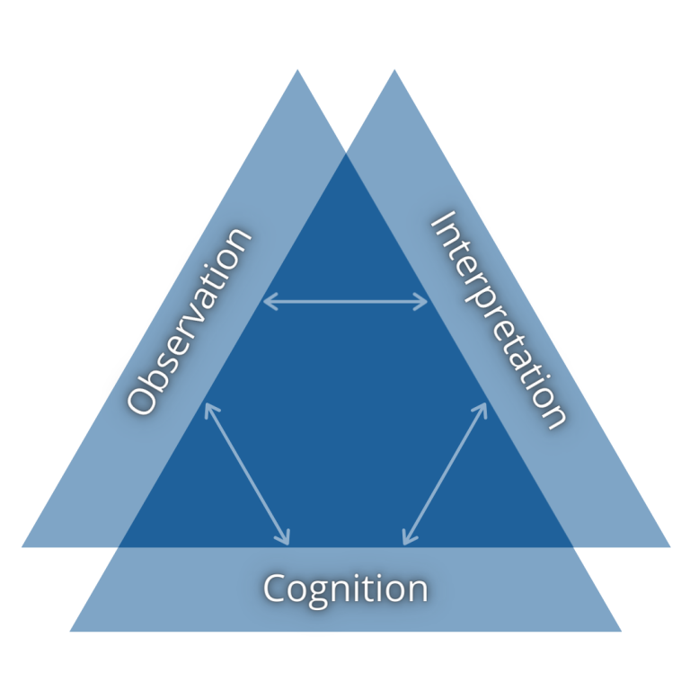
Building Assessments
01
Be clear about what you want your students to know.
02
How will you be able to observe that? How could a student possibly avoid demonstrating that competency if they have it?
03
Interpret what you’re seeing students do in ways that actually tell you about the underlying learning outcome you wanted
The Ohio Center for Law Related Education
Notes:
Assessments may also need to be modified to accommodate your exceptional learners. These are the three sides you want to keep in mind as you might expand the idea of what the assessment could look like

Slide 10

Curb Cut Effect
01
Student Choice
02
Routines & Expectations
03
Supporting Executive Functioning Skills
The Ohio Center for Law Related Education
Notes:
Student choice helps all students to become more engaged and invested in their learning. They get to see themselves as having agency and like their voice matters, and tends to bring out their best efforts. Projects where they're getting to show the same skills but in different modalities can help not only your students who need those accommodations but also your apathetic students who don't have any identified learning needs. Other ways to increase student choice include giving options to incorporate a special interest when there is a broad topic that allows some flexibility and giving students options for what to do first or next on "work days"

Slide 11
Routines & Expectations
That especially support students with exceptionalities
Open Classroom Climate
Predictability
Democratically Set Expectations
Having a predictable routine for how your class starts
Providing students with an outline of today’s class, the week overall, and the entire unit
Community, belonging, & trust in the classroom helps overcome learned helplessness
An open classroom climate leads to student emotional engagement with the class, history efficacy, viewpoint pluralism, civic commitments, & civic engagement
You set the values; the class determines what they “look like” in practice
Everyone owes the class “today’s best”
The Ohio Center for Law Related Education
Notes:
The open classroom climate especially supports students w/ exceptionalities because it supports asking for help & being open about the diversity among all students' learning needs
Predictability also especially supports these students because it can take away from the mental load and creates a sense of comfort in your classroom. Plus, if your Intervention Specialist works with your students on their social studies work, it will help make them like you because it adds a level of communication about what work they have for your class.
The expectation of "today's best" means that your ability and "bandwidth" might be different, but do the best you can every day. This expectation highlights our collective humanity & is especially good for students with exceptionalities because their "good days" and "off days" can vary widely, and this expectation tells them that you won't hold them to their best days every day and that a bad day won't set them back in your eyes.

Slide 12
(Some) Executive Functioning Skills
ORGANIZATION
TIME MANAGEMENT
PLANNING & PRIORITIZING
  Adding a picture/icon that is UNIQUE to each handout to help students identify them
  Printing important, perennial documents on colored paper
  Detailed timelines with deadlines for every step in the process
  Providing estimates for how long classroom tasks may take
  Visual timers during independent work in class
  Providing students with an outline of the unit at the start
  Categorizing assignments
  Public and private trackers for assignments
  Eisenhower Matrix
TASK INITIATION
METACOGNITION
WORKING MEMORY
  Choices for what to work on first
  Break the task down into smaller chunks
  Make it urgent with deadlines for each step in the process
  Public & private assignment tracker
  Working in ”check-in” self-monitoring tasks (ex: emoji check-in)
  Reviewing procedures & routines
  Reviewing information
  Posting reminders of information, procedures, routines, & ongoing tasks
The Ohio Center for Law Related Education
Notes:
ALL students in middle and high school have difficulties with executive functioning as they are in the stage of development where the part of their brain (frontal lobe) that controls these is growing & developing
Defining terms:
Organization: the ability to create and maintain systems to keep track of information and materials. These are 2 examples of how you might set up these systems for your students and help them keep their things organized.
Time management: the capacity to estimate how much time one has, how to allocate it, and how to stay within time limits and deadlines. A sense of urgency is often even necessary for our students with disabilities (especially neurodivergent students) to be motivated, so having deadlines for each step will help keep them on track, telling them how long something might take & giving a visual timer helps keep them on track and aware of whether they are going to need extra time/if they are taking too long on the assignment
Planning & prioritizing: The ability to create a roadmap to reach a goal or complete a task. Also involves being able to make decisions about what's important to focus on and what's not. Categorizing: I used Modern Classrooms Project labels of "must do/should do/aspire to do" to show students which tasks were most important to them gaining mastery of the content and being able to complete the assessment they are working toward. I also used Modern Classrooms Project's trackers on independent work days so students could see what they needed to work on, who they might work with on assignments, and encourage others to "catch up" with them so they could work together. Students also had unit trackers in their binders so they could check off tasks as they finished them and then got them back & didn't need to revise them. Einstein Matrix: a 4-box grid for sorting tasks based on their importance on one axis and urgency on the other (a printable worksheet is in the pdf my sources slide links to).
Task initiation: the ability to begin projects without undue procrastination, in an efficient or timely fashion. Choices for what to do next especially helps students who have "hit a wall" and need to do something while they wait for help (or just to cool off before trying again)
Metacognition: the ability to stand back and take a bird's-eye-view of oneself in a situation. Observing how you problem-solve. Self-monitoring and self-evaluation skills. The "emoji check-in" was a tool I used where I literally filled a Google Doc with a variety of emojis, downloaded it as a PDF, and printed 4 to a sheet and cut it up. I would prompt students to circle the emojis that reflected how they felt about the day's lesson, or where they were in a unit's tasks, and then explain their selections on the back.
Working memory: the ability to hold information in memory while performing complex tasks. Incorporates the ability to draw on past learning or experience to apply to the situation or to project into the future.

Slide 13
Sources
“Building Access to DBQs for Multilingual Learners.” Kristen Tabacco, Massachusetts Council for the Social Studies, Lynn Public Schools. Presentation at NCSS 2025. masscouncil.org/professional-development/building-access-to-dbqs-for-multilingual-learners/
“Empowering English Learners in Social Studies: Building a Stronger Democracy Together.” Leah Renzi & Laurel Williams. Presentation at NCSS 2025.
“We the People: National Symposium on Civic Education Research.” 6-7 March 2026. https://civiced.org/symposium/video
“The Smart but Scattered Guide to Success.” Peg Dawson, EdD & Richart Guare, PhD. 2016. The Guilford Press. p. 19-26.
“How to Not NEED as Much Motivation to do the Thing.” HowToADHD. 12 October 2021. youtu.be/w7eWb0nINPg?si=OK6XWY_iJJf08mJw
“How a Modern Project-Based Classroom Leads to the Ultimate Learner Experience.” Kristen Moore. Next Generation Learning Challenges. 26 April 2021. https://www.nextgenlearning.org/articles/empowering-students-as-authors-of-their-own-education
“The Importance of Student Choice Across All Grade Levels.” Stephen Merrill, Sarah Gonser. Edutopia. 16 September 2021. https://www.edutopia.org/article/importance-student-choice-across-all-grade-levels/
"The Eisenhower Matrix." Columbia University School of Professional Studies Office of Student Support. https://sps.columbia.edu/sites/default/files/2023-08/Eisenhower%20Matrix.pdf
The Ohio Center for Law Related Education

Slide 14
Contact Information
DANNY RAINS
E-mail
drains@oclre.org
Phone
614-485-3514
Company
OCLRE
The Ohio Center for Law Related Education

Slide 15

The Ohio Center for Law Related Education | Est. 1984
THANK YOU

