Slide 1

The Ohio Center for Law Related Education | Est. 1983
APPLIED LITERACY FOR WE THE PEOPLE
PRESENTED BY:
DATE:
PROGRAM(S):
Danny Rains
10/22/2025
High School We the People
Middle School We the People

Slide 2


Applied Literacy Skills
Research Skills
Writing
Text Analysis
Argumentation

Slide 3

What do you currently do to support your students in the research process and to help them identify whether a source is credible?
The Ohio Center for Law Related Education

Slide 4
Supporting Students’ Research Skills
What all goes into supporting students’ ability to do their own research?
Goal # 1
Goal # 2
Helping students identify whether a source is credible
Explicitly teaching the research PROCESS
The Ohio Center for Law Related Education

Slide 5

Identifying Whether a Source is Credible
01
Vetting sources ahead of time
02
News Literacy Project: Checkology
03
AllSides Media Bias Chart
04
SIFT Method
05
CRAAP Test
The Ohio Center for Law Related Education

Slide 6
SIFT Method for Evaluating Sources
An evaluation strategy developed by digital literacy expert Mike Caulfield
FIND Better Coverage
TRACE Claims, Quotes, & Media
STOP
INVESTIGATE
Be aware of your emotional response to the headline or information in the article.
Consider:
What do you already know about this topic?
What do you already know about the source? Do you know its reputation?
What can you find out about the author & website creators?
What is their mission? Do they have vested interests? Would their assessment be biased?
Do they have authority in this area?
Use lateral reading to see what other trusted sources say about the source
Try to find other sources corroborating the same information or disputing it.
What coverage is available on the topic?
Keep track of trusted news sources.
Use Fact Checkers:
BBC RealityCheck
Reuters Fact Check
Locate the original source of information: follow their source links and reporting sources listed in bibliography.
Was the claim, quote, or media fairly represented?
Does the extracted information support the original claims in the research?
Is it being cherry-picked to support an agenda or a bias?​
Is it being taken out of context?​
The Ohio Center for Law Related Education

Slide 7
CRAAP Test
For evaluating the validity and credibility of sources
Currency
Relevance
Authority
Is the information recent?
Does it reflect the most up-to-date facts on the topic?
Does the source relate to the subject or issue at hand? Is it appropriate for the audience?
Who is the author or publisher? What are their qualifications or affiliations?
Also consider: what is their reputation?
Accuracy
Purpose
Is the information supported by evidence? Are the sources cited?
Also consider: Is the claim backed up by credible sources, or does it rely on vague statements and unverified facts?
Why was this source created? Is it trying to inform or persuade the audience? Is it meant to sell something?
Also consider: Is the headline designed to evoke a strong emotional response?
The Ohio Center for Law Related Education

Slide 8

Explicitly Teaching the Research Process
01
Conducting research alongside/ahead of the teaching to better design the learning experience
02
Using graphic organizers to help students keep their research notes organized
03
Creating and refining research questions
04
Using Wikipedia & the sources other authors cite
05
Using Google Scholar
The Ohio Center for Law Related Education

Slide 9
Creating & Refining Research Questions
Begin with Key Words
Focus on Specifics
Be Open to Change
Take the big topic students want to research & have them list all key words associated with their idea.
EX: for a research project on the impact of social media on student health, they might list: social media, mental health, anxiety, depression, cyberbullying, TikTok, addiction, etc.
Write out their big research question, then underline all the nouns. Look at those words and brainstorm how to make them more precise.
Ex: “How does social media affect teenagers?” might become “How does TikTok’s algorithm affect high school students’ sleep patterns?
Encourage students to be open to changing their research question if and when their evidence leads them to or away from a specific focus within their topic
The Ohio Center for Law Related Education

Slide 10

What strategies do you currently use to support student writing in your classroom?
The Ohio Center for Law Related Education

Slide 11
Supporting Students’ Writing
What all goes into supporting students’ writing skills?
Goal # 1
Goal # 2
Goal # 3
Understanding the prompt/question
Outlining a response
Proofreading
The Ohio Center for Law Related Education

Slide 12

Understanding the Prompt
01
Explicitly teach academic vocabulary verbs
02
How to identify where academic vocabulary verbs are implied
03
How to break down a question into a checklist for response
The Ohio Center for Law Related Education

Slide 13
Breaking Down a Sample Prompt
Since the colonial era, people have expressed their dissatisfaction with government through acts of political protest. However, some protesters are celebrated while others are vilified. What factors determine whether participants in public demonstrations are viewed as patriots or traitors?
What, if any, common factors exist in both historical and contemporary demonstrations that are viewed as valid and patriotic?
Under what circumstances, if any, should the government intervene to curtail political protests?
Justify which factors determine whether participants in public demonstrations are viewed as patriots or traitors.
Compare and contrast historical and contemporary demonstrations that are viewed as valid and patriotic.
Argue under what circumstances, if at all, the government should intervene to curtail political protests.
The Ohio Center for Law Related Education

Slide 14
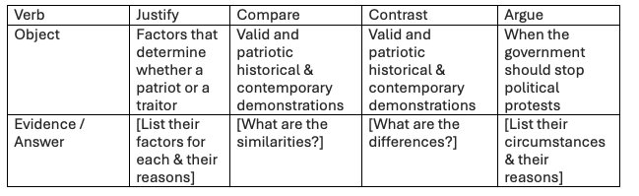
Turn the Prompt into a Checklist
The Ohio Center for Law Related Education

Slide 15

Outling a Response
01
Restate and Answer the Question
02
Give & Explain Evidence
03
Summarize and Transition
The Ohio Center for Law Related Education

Slide 16
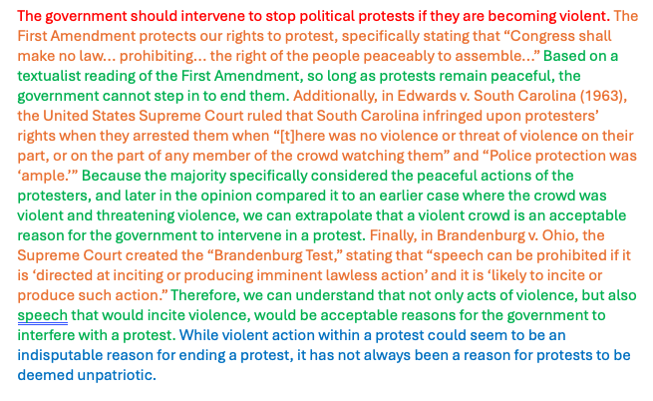
Sample Response
Color Key:
Restate & Answer
Give Evidence
Explain Evidence
Summarize & Transition
The Ohio Center for Law Related Education

Slide 17
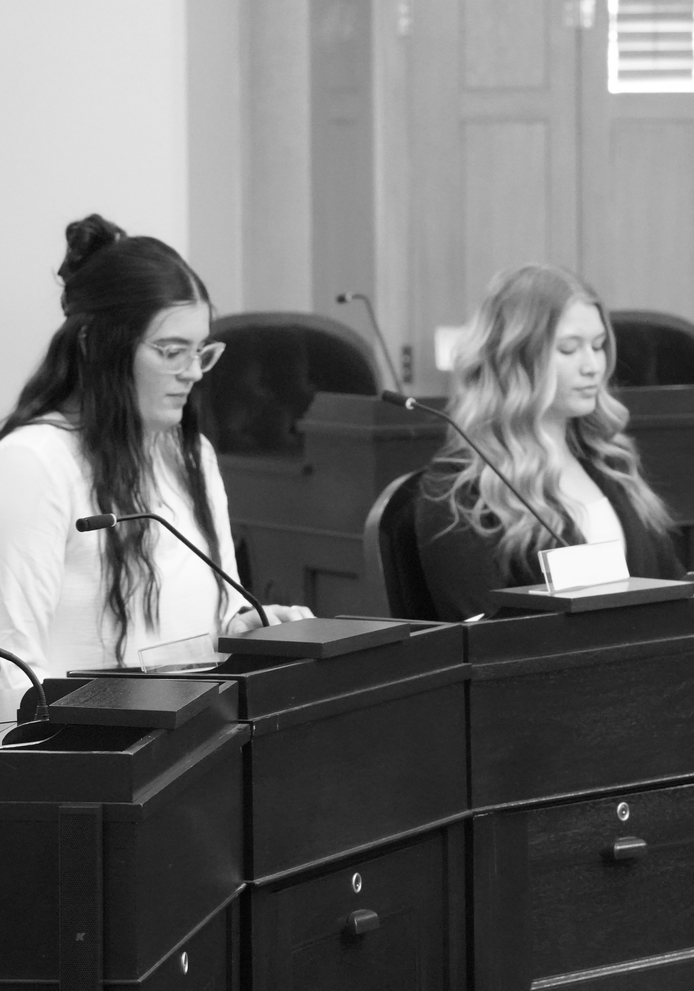
Proofreading Strategies
01
Highlighting your draft
02
Having a peer read your paper aloud to you
The Ohio Center for Law Related Education

Slide 18

What strategies do you currently use to support students as they read complex texts in your classroom?
The Ohio Center for Law Related Education

Slide 19

Effective Annotation Strategies
01
Annotation for engaging with the text
02
Annotation to prepare for a task
03
Double-Entry Journals
The Ohio Center for Law Related Education

Slide 20

Annotation to Engage with the Text
Capture students’ thinking as they’re reading
Give students specific prompts, such as:
  Circle the words you don’t understand
  Highlight anything that stands out as interesting or possibly important
  Underline anything that confused you and draw a question mark in the margins nearby
  Write a prediction or connection to another text we’ve read or current events in the margins
The purpose is to help keep students focused and work on metacognition skills
The Ohio Center for Law Related Education

Slide 21
Annotation For Your Future Self
Students annotate most effectively when they know what they are annotating FOR
Step # 1
Step # 2
Step # 3
Give students the question they will be asked to respond to before they read the text. As they read, they should identify passages that connect with that question.
After they have read the passage and identified passages, students should narrow these down to the ones they think are most relevant. On a separate paper, they should write about what they notice about those passages, how they are helpful to answering the question, and how they connect to larger ideas they’ve been learning about in class in this unit.
Students will then summarize their thoughts from Step 2 into a short, clear note to record in the margin of the text or on a sticky note to put into the book beside the passages they identified in Step 1.
The Ohio Center for Law Related Education

Slide 22
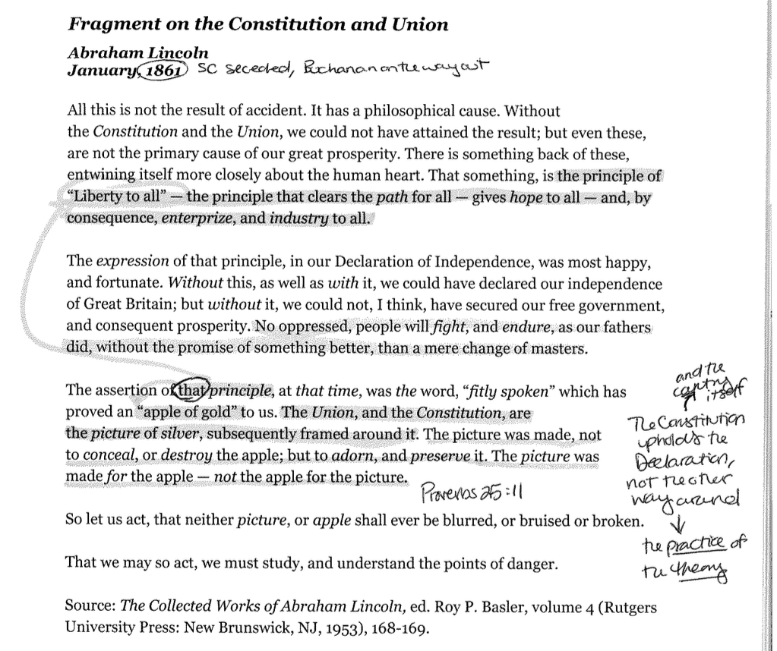
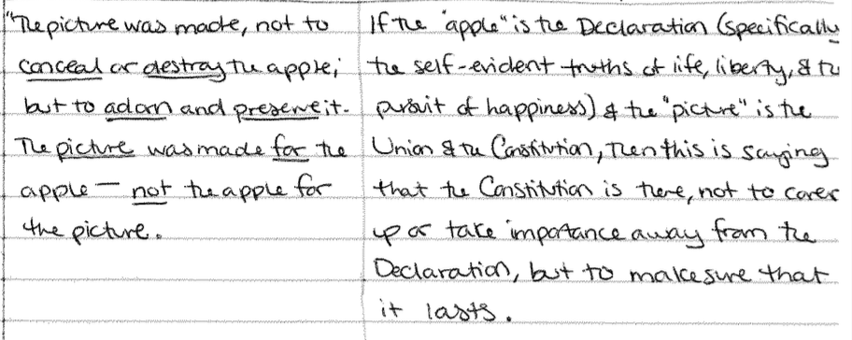
Example of the Annotation Process
The Ohio Center for Law Related Education

Slide 23
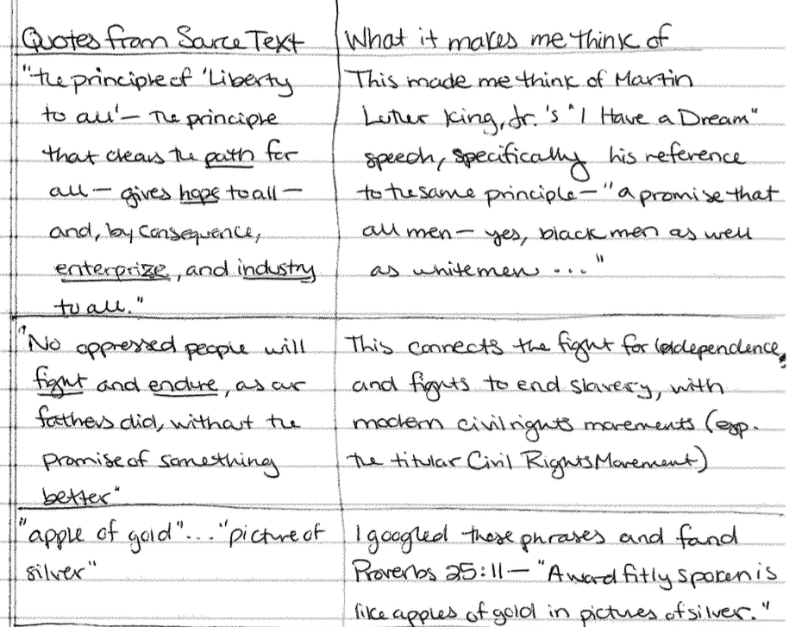
Double-Entry Journals
The Ohio Center for Law Related Education

Slide 24
Sources
“7 Essential Research Hacks to Teach High School Students” by Benjamin Barbour. Edutopia. 14 November 2025. Edutopia.org/article/research-tips-high-school-students
“We Need to Rethink How We Teach Research” by Curtis Chandler. MiddleWeb. 24 March 2026. middleweb.com/53240/we-need-to-rethink-how-we-teach-research
”Teaching ELA Students to Annotate with Purpose” by Laurie Millie Hornik. MiddleWeb. 13 April 2026. middleweb.com/53311/teaching-ela-students-to-annotate-with-purpose
AllSides Media Bias Chart: allsides.com/media-bias/media-bias-chart
“Evaluating Resources and Misinformation” by Kaitlyn Van Kempen. UChicago Library. 30 June 2025. guides.lib.uchicago.edu/c.php?g=1241077&p=9082322
“How to Evaluate the Trustworthiness of Sources” ThinkingPro. 4 November 2024. thinkinghabitats.com/blog/how-to-evaluate-the-trustworthiness-of-sources
“Use Google Scholar’s Advanced Search Feature” UC Santa Cruz University Library. https://guides.library.ucsc.edu/c.php?g=745384&p=5361954
The Ohio Center for Law Related Education

Slide 25
Contact Information
DANNY RAINS
E-mail
drains@oclre.org
Phone
614-485-3514
Company
OCLRE
The Ohio Center for Law Related Education

Slide 26

The Ohio Center for Law Related Education | Est. 1984
THANK YOU

