Slide 1
Persuasive Statement of Facts
Professor Katherine Silver Kelly
Clinical Professor of Law
The Ohio State University Moritz College of Law

Slide 2
Foundation
Logos-Pathos-Ethos
Basics
Definition
Goals & Purpose
Pro Tips
Fact Check
Balance Interests
Process
Stages
Identify, Sort, Weed
Strategize
Citations
AGENDA

Slide 3
Persuasion Foundation
Logos
Ethos
Pathos
Effective Persuasion Combines All Three
Start with Substance
Build Empathy
Establish Credibility

Slide 4
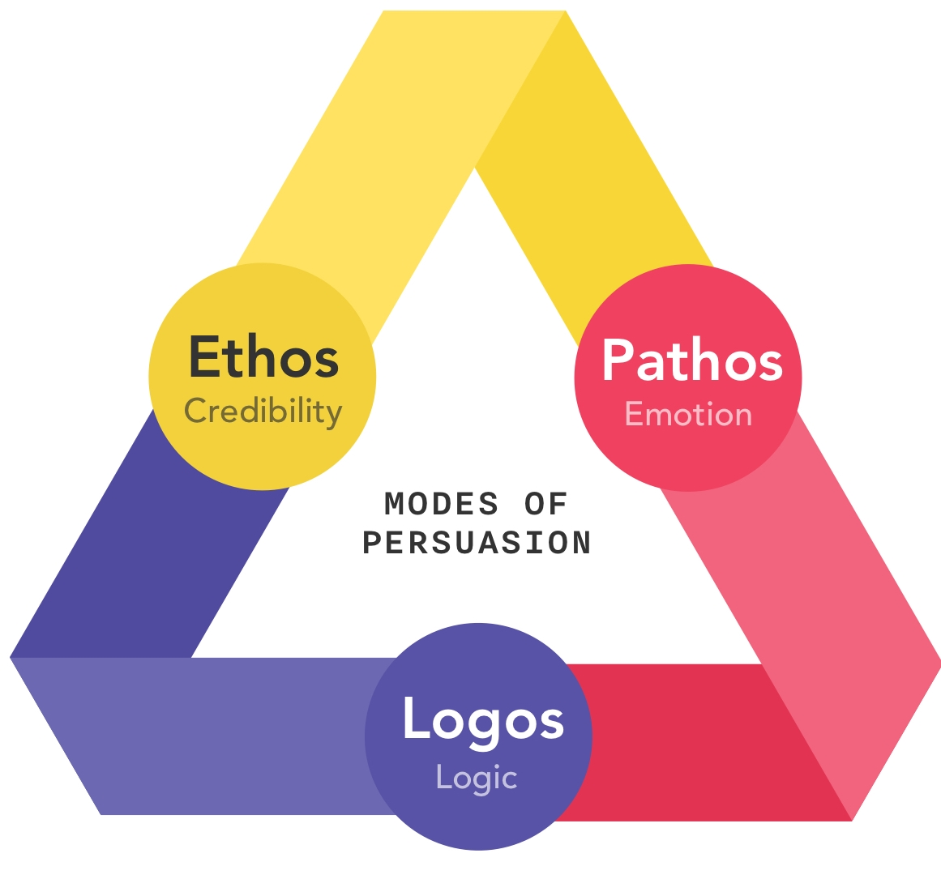
Persuasion Foundation
Persuasion is a Skill
Ethos- source of message
YOU- what are you doing to enhance or detract from message
Logos- content of message
Is means used to reach the result a logical one
Pathos- audience reading the message
Are you considering the diverse individuals w/ different goals

Slide 5
The Basics- Definition
Official Definition- FRAP 28(a)(6)
“A concise statement of the case setting out the facts relevant to the issues submitted to review, describing the relevant procedural history, and identifying the rulings presented for review, with appropriate references to the record.”
Two Categories: Process & Substance
Relevant to Process- litigation steps
Relevant Substance- background/context and legal issues

Slide 6
The Basics: Goals & Purpose
It’s about the ending
Trial court wrote the story
Appeal asks court to change the ending or keep the same
Persuasive and consistent
Should not clash with trial court opinion or opposing side’s facts
Dramatic differences jeopardize credibility

Slide 7
The Basics: Goals & Purpose
Statement. Of. Facts.
NOT a conclusion of facts
NOT a statement of law
Factual foundation for legal argument
Narrative from your POV- accurate & persuasive
NOT an argument
Include every fact
Even the bad ones
Especially the bad ones

Slide 8
It’s a Process
Stages of Process
Identify, Gather & Sort
Weed Out
Strategize- Theme & Details
Pro Tips: Fact Check, Balancing Interests, Citations

Slide 9
Stages of the Process
Early- basic understanding of issues, context
During- identify relevant details
Later- complete story
First draft not your last draft.

Slide 10
Identifying, Gathering & Sorting Facts
Categories to Identify:
Legally Significant
Context
Emotional Appeal
Not sure
Gather & Sort
Working List- type of fact, why it’s relevant, source in record
Revisit File Regularly

Slide 11
Weed Out Irrelevant Facts
Don’t Include Everything “Just in Case…”
Audience perspective- if it’s there, it must be important
Too many details ruins the story
Facts to Consider- What Matters to the Story
Dates & Times: precise date or time something occurred OR the order and sequence of events
Names: person’s name important OR their role/category
Places: specific location significant OR the type of place

Slide 12
Example: Irrelevant Facts Distract
On the morning of December 3, 2024 Alvina Preston and Zelda Silver met at Preston’s office located at 359 Fifth Street, Canton, Ohio, and began negotiating a contract for the sale of metal tubing. Cite. They negotiated for an hour before Silver had to leave for another meeting. Cite. Preston and Silver met again at Preston’s office on December 23, 2024 and reached a tentative agreement, but on January 2, 2025 determined that they were unsatisfied with that tentative agreement. Cite. It was not until February 28, 2025 that they reinitiated negotiations and met again at Preston’s office. Cite. The contract was finalized on April 3, 2025. Cite.

Slide 13
Big Picture Strategy
Bring facts together with a theme
Preserve the good- stability, trust, freedom, responsibility, loyalty, honesty, etc.
Prevent the bad- abuse, laziness, recklessness, slippery slopes, stealing, etc.
Tell a story that makes sense
Read the story out loud.

Slide 14
Strategic Details
Headings
Organizing principle, preview argument
Headings create separation, not connections
Points of Emphasis
Beginning and end v middle
Document, paragraph, sentence
Buddy System
Pair up good and bad facts to “neutralize” the bad (at least don’t highlight it)

Slide 15
Write Facts. Only Facts
Fact- objective, discoverable truth
Inference- conclusion drawn from facts
Characterization- opinion about a fact

Slide 16
Example
Plaintiff Larkin McConnell is a scholarship student who came to Defendant University of Kentucky to run on its cross country team. McConnell Depo. 8. Less than a year after Ms. McConnell arrived, UK eliminated the women’s cross country team. Bleaker Depo. 15. UK plans to replace cross country with a sport not yet recognized by the NCAA: cheerleading. Id. at 22. Ms. McConnell now seeks to enjoin UK from eliminating women’s cross country on the grounds that eliminating cross country and replacing it with cheerleading violates Title IX. Am. Compl. 8.
Plaintiff Larkin McConnell is a gifted student and nationally ranked cross country runner. She came to Defendant University of Kentucky to run on the varsity cross country team. McConnell Depo. 10-11. Less than a year after Ms. McConnell arrived, UK suddenly and inexplicably eliminated the women’s team. Bleaker Depo. 15. UK plans to replace cross country with an activity that is not even a recognized sport: cheerleading. Id. at 22. Ms. McConnell now seeks to enjoin UK from eliminating its cross country team on the ground that eliminating cross country for no reason and replacing it with cheerleading would violate Title IX. Am. Compl. 8.

Slide 17
Pro Tips
Fact Check
Balancing Interests
Citation

Slide 18
Pro Tip: Fact Check
Highlight specific facts in your argument/analysis
Highlight those facts in the record or case file
Cross-Check with your statement of facts
Go back to the record, identify “leftover” facts, articulate why they’re not legally significant
“It doesn’t seem relevant to me because…”

Slide 19
Pro Tip: Balancing Interests
Your Potential Argument List | Prediction of Opposing Side Potential Argument List
Problem to resolve Potential “good” to preserve Potential “bad” to prevent Material facts of dispute Material policy facts to consider Potential legal rules to apply Proposed resolution of problem | Problem to resolve Potential “good” to preserve Potential “bad” to prevent Material facts of dispute Material policy facts to consider Potential legal rules to apply Proposed resolution of problem

Slide 20
Balancing Interests- Identify Key Points
Which theme is best?
Which 5 facts relating to specific disputes are best?
Which 5 policy facts best inform court as to overall implications of dispute?
Which legal rule is best?
Why are these arguments better than the other side’s?
DO THIS FOR BOTH SIDES OF BALANCE SHEET

Slide 21

Pro Tip: Citations
Specific citation to sources.
Proves info is reliable.
If you can’t cite to a specific place in the record, it’s probably not a fact.

