Slide 1

Avoiding Citation and Formatting Headaches
Professor Jennifer goldson
Capital University Law school
Notes:
We are going to be talking about federal citation format. Notice that I said that we’re focusing on federal citation format. States have different citation rules. In Ohio, you can get a copy of the Ohio Supreme Court’s writing manual the OSC’s website. If provides the proper citation format to be used for filing documents in the Ohio state courts.
Federal citation format is dictated the BlueBook. If you plan on being a litigator, you should expect to become pretty familiar with the book.
As we dig into cite form, you’re going to notice that there are lot of little details. And you’re probably going to ask yourself, does it really matter, so long as they parties and the court can find the case?
The answer it, it does. Presenting a polished document to the court helps both your reputation and credibility. If you don’t take the time to pay attention to the details, you look careless, and a court isn’t going to trust your work or your word.

Slide 2
Why is citation format important?
Gives credibility to your legal writing
Provides a common pattern that legal scholars understand
Separates citation from text for ease of readability without having to find a footnote

Slide 3
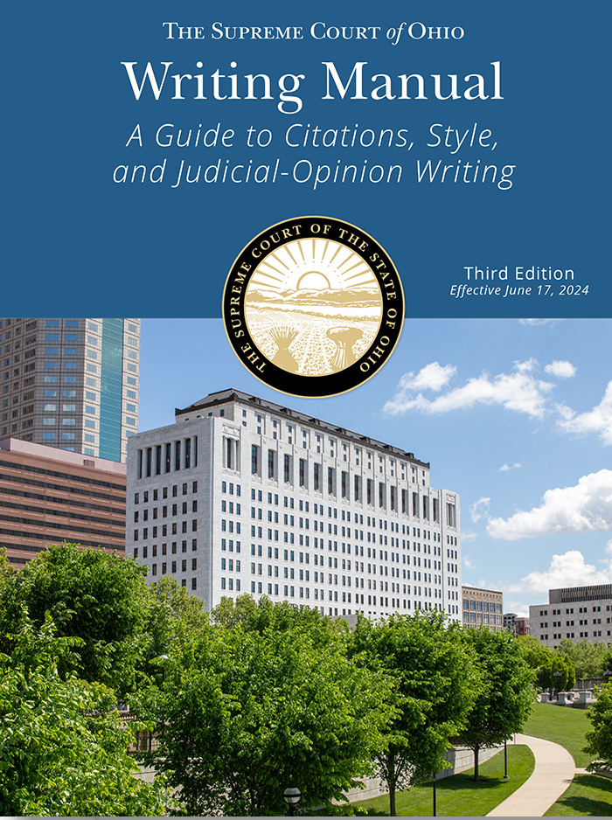
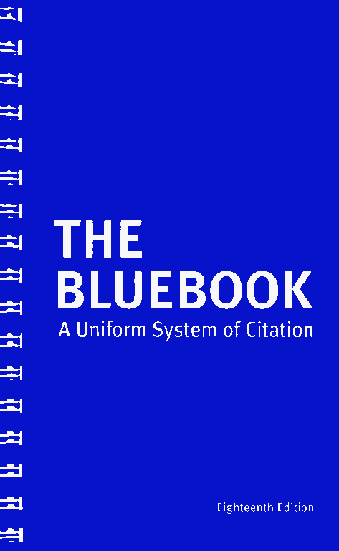
Main Citation Sources - Ohio

Slide 4

Components of a Case Citation
What must you include in a citation
  Case name
  Official reporter citation
  Pinpoint cite
  Court
  Year

Slide 5
Reporter Volume No.
Reporter Title
Court
Pincite
Roe v. Wade, 314 F. Supp. 1217, 1222 (N.D. Tex. 2003).
Plaintiff (last name of the first plaintiff only)
Page on which case begins
Year the decision was issued
Defendant (last name of first defendant only)

Slide 6

Identify the Court
Roe v. Wade, 314 F. Supp. 1217, 1222 (N.D. Tex. 2003).
Federal Courts of Appeals: 1st Cir., 2d Cir., 3d Cir, 4th Cir., 5th Cir., 6th Cir., 7th Cir., 8th Cir., 9th Cir., 10th Cir., 11th Cir., 12th Cir., D.C. Cir. Fed. Cir.
Examples of District Courts: S.D. Ohio, N.D. Ohio, M.D. Fla., S.D. Cal., N.D. Ala., E.D. Cal. S.D.N.Y.
EXCEPTION: When citing to the United States Supreme Court, you do not need to identify the Court in the parenthetical.
Anyone know why?

Slide 7
Common federal official reporters
United States Supreme Court
Cite to the United States Reports = U.S.
Ex. Tommy v. Smith, 27 U.S. 46, 47 (2003).
Federal Circuit Courts of Appeal
Cite to the Federal Reporter when available = F.; F.2d; F.3d; F.4th
Federal district courts
Cite to the Federal Supplement when available = F. Supp.; F. Supp. 2d; F. Supp. 3d

Slide 8
Spacing and italics
A period is placed at the end of your substantive sentence as well as at the end of your citation sentence.
Roe*v.*Wade,*314*F.*Supp.*1217,*1222*(N.D.*Tex.*2003).
Each * represents a space
  Tip: If two abbreviations are no more than one letter, do not separate them with a space. For example, Northern District of Texas is abbreviated N.D.*Tex.
The case name must be italicized or underlined. But do NOT underline or italicize the comma.

Slide 9

Pincites
What is a pincite?
  It is the page upon which the particular proposition may be found.
When must you include a pincite?
  Typically, you should always include a pincite.
What do you do if your pincite spans several pages?
Smith v. Lee, 45 F.3d 7, 8-9 (6th Cir. 2007).
Enlow v. Hansen, 16 F. Supp. 45, 60-61 (S.D. Ohio 2009).
West v. Maker, 75 U.S. 1350, 1351-52 (2010).
Lyft v. Uber, 23 F.2d 97, 99-100 (2d Cir. 2005).
Member v. Elon, 87 F. App’x 1891, 1899-1900 (Fed. Cir. 2012).

Slide 10
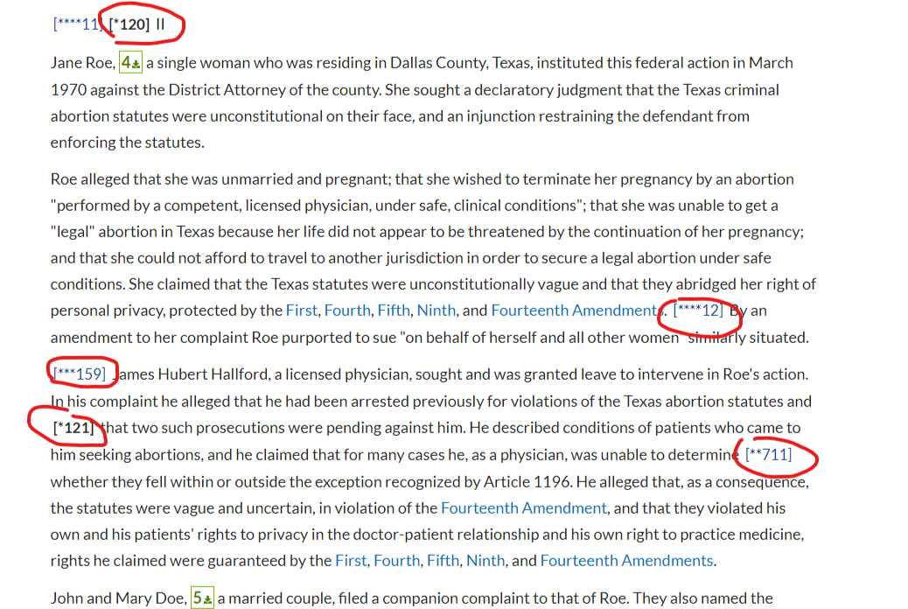
Pinpoint Cites
When citing to a case for a proposition of law or if you are quoting a case, you must identify the page that the proposition or quote may be found on.
TIPS: When you include a pinpoint cite, make sure that you are citing the opinion and not the syllabus or headnotes
Make sure that you are not using a pinpoint cite that belongs to another reporter
Notes:
Always include a pinpoint cite.

Slide 11
Include the Year of the Decision
Roe v. Wade, 314 F. Supp. 1217, 1222 (N.D. Tex. 2003).
Identify the date the court issued the decision—not the date the case was submitted for decision or argued before the court.
Then, put a period at the end of your citation sentence.
TIP: f you are citing multiple cases for the same proposition, separate the cases by a semicolon.
  United States v. Smith, 321 F.3d 347, 350 (6th Cir. 2017); Roe v. Wade, 314 F. Supp. 1217, 1222 (N.D. Tex. 2003).

Slide 12

Unpublished Decisions
In addition to the information that must be included with a published citation, cites to federal unpublished decisions must include:
Case Number (docket number)
Full decision date
Black v. Le, No. 3:18-cv-2771, 2019 U.S. Dist. LEXIS 7936, at *7 (S.D. Cal. Jan. 15, 2019).
NOTICE: the “at *” that comes before the pinpoint cite

Slide 13
Last name of first defendant
Issuing court
Electronic web address
Black v. Le, No. 3:18-cv-2771, 2019 U.S. Dist. LEXIS 7936, at *7 (S.D. Cal. Jan. 15, 2019).
Pincite
Last name of first plaintiff
Full date that the decision was issued
Case number
You do NOT need to include an electronic address for both LEXIS and Westlaw – it is sufficient to include only one

Slide 14
Pinciting unpublished cases
Black v. Le, No. 3:18-cv-2771, 2019 U.S. Dist. LEXIS 7936, at *7 (S.D. Cal. Jan. 15, 2019).
Include at and an asterisks before the specific page being cited

Slide 15
Spacing: The same rules apply
Black v. Le,^No.^3:18-cv-2771,^2019^U.S.^Dist.^LEXIS^7936,^at^*7^(S.D.^Cal.^Jan.^15,^2019).
Notice that there is no space between the asterisks and the pincited page

Slide 16
Electronic web address
Last name of first defendant
Issuing court
Byer v. Wright, 2005-Ohio-1797, ¶ 12 (11th Dist.).
Last name of first plaintiff
Pincite
Ohio state courts require less information when the case is available online

Slide 17

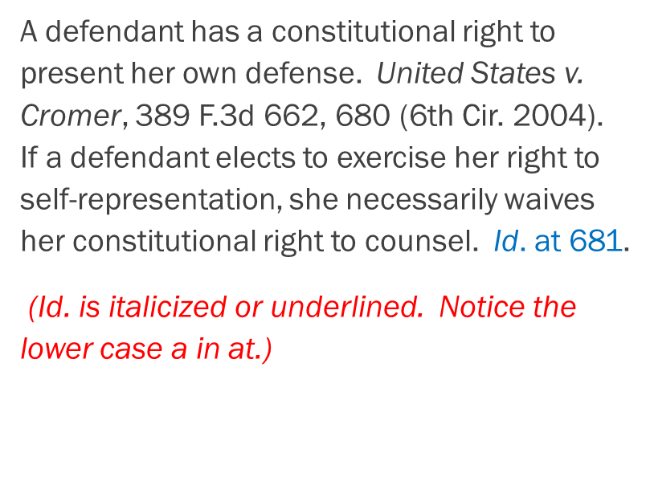
Good news!
You can use short citations after you have already included the full citation to the case, as long as:
1. The reader will be clearly able to ID the referenced case;
2. The full citation falls in the same general discussion; and
3. The reader will be able to find the full citation easily.

Slide 18

What about those parentheticals?
Parentheticals are used for three reasons:
1. To explain weight of the authority;
2. To quote or cite another authority;
3. To explain more about the authority beyond what you’ve included in your textual sentence.
Abrams v. United States, 250 U.S. 616, 626 (1919) (Holmes, J., dissenting).
United States v. Windsor, 570 U.S. 744, 774 (2013) (citing Bolling v. Sharpe, 347 U.S. 497, 499-500 (1954)).
United States v. Windsor, 570 U.S. 744, 775 (2013) (recognizing that the class of people restricted by DOMA are those who are “joined in same-sex marriages made lawful by the State.”).

Slide 19

Other Material that is Frequently Cited

Slide 20
Statutes
Title – Code – Section - Subsection (if applicable) - (Year).
28 U.S.C. § 1332 (2006).
Short Form
If the statute and pincite information are the SAME as preceding authority = Id.

Slide 21
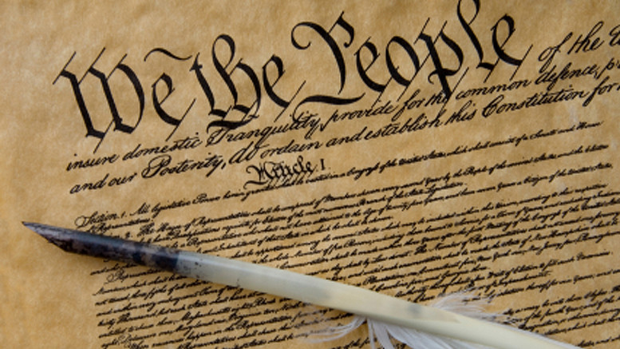
Constitution
U.S. Const. - Article or Amendment – Section - Subsection (if appropriate).
► U.S. Const. art. III, § 1.
► U.S. Const. amend. XIII.
Short Form
► ONLY use ”Id.” IF you are citing the same provision
► Otherwise, you must use the FULL citation

Slide 22
Rules & Regulations
Rules
Title - Number - Subsection (if one).
► Fed. R. Civ. P. 15(a).
► Fed. R. Crim. P. 11(a).
Regulations
Title - C.F.R. - Section - Year
► 21 C.F.R. § 900.12 (2014).
Include the name of the regulation if it has a commonly referred to name
► FCC Broadcast Radio Servs., 47 C.F.R § 73.609 (2014).

Slide 23
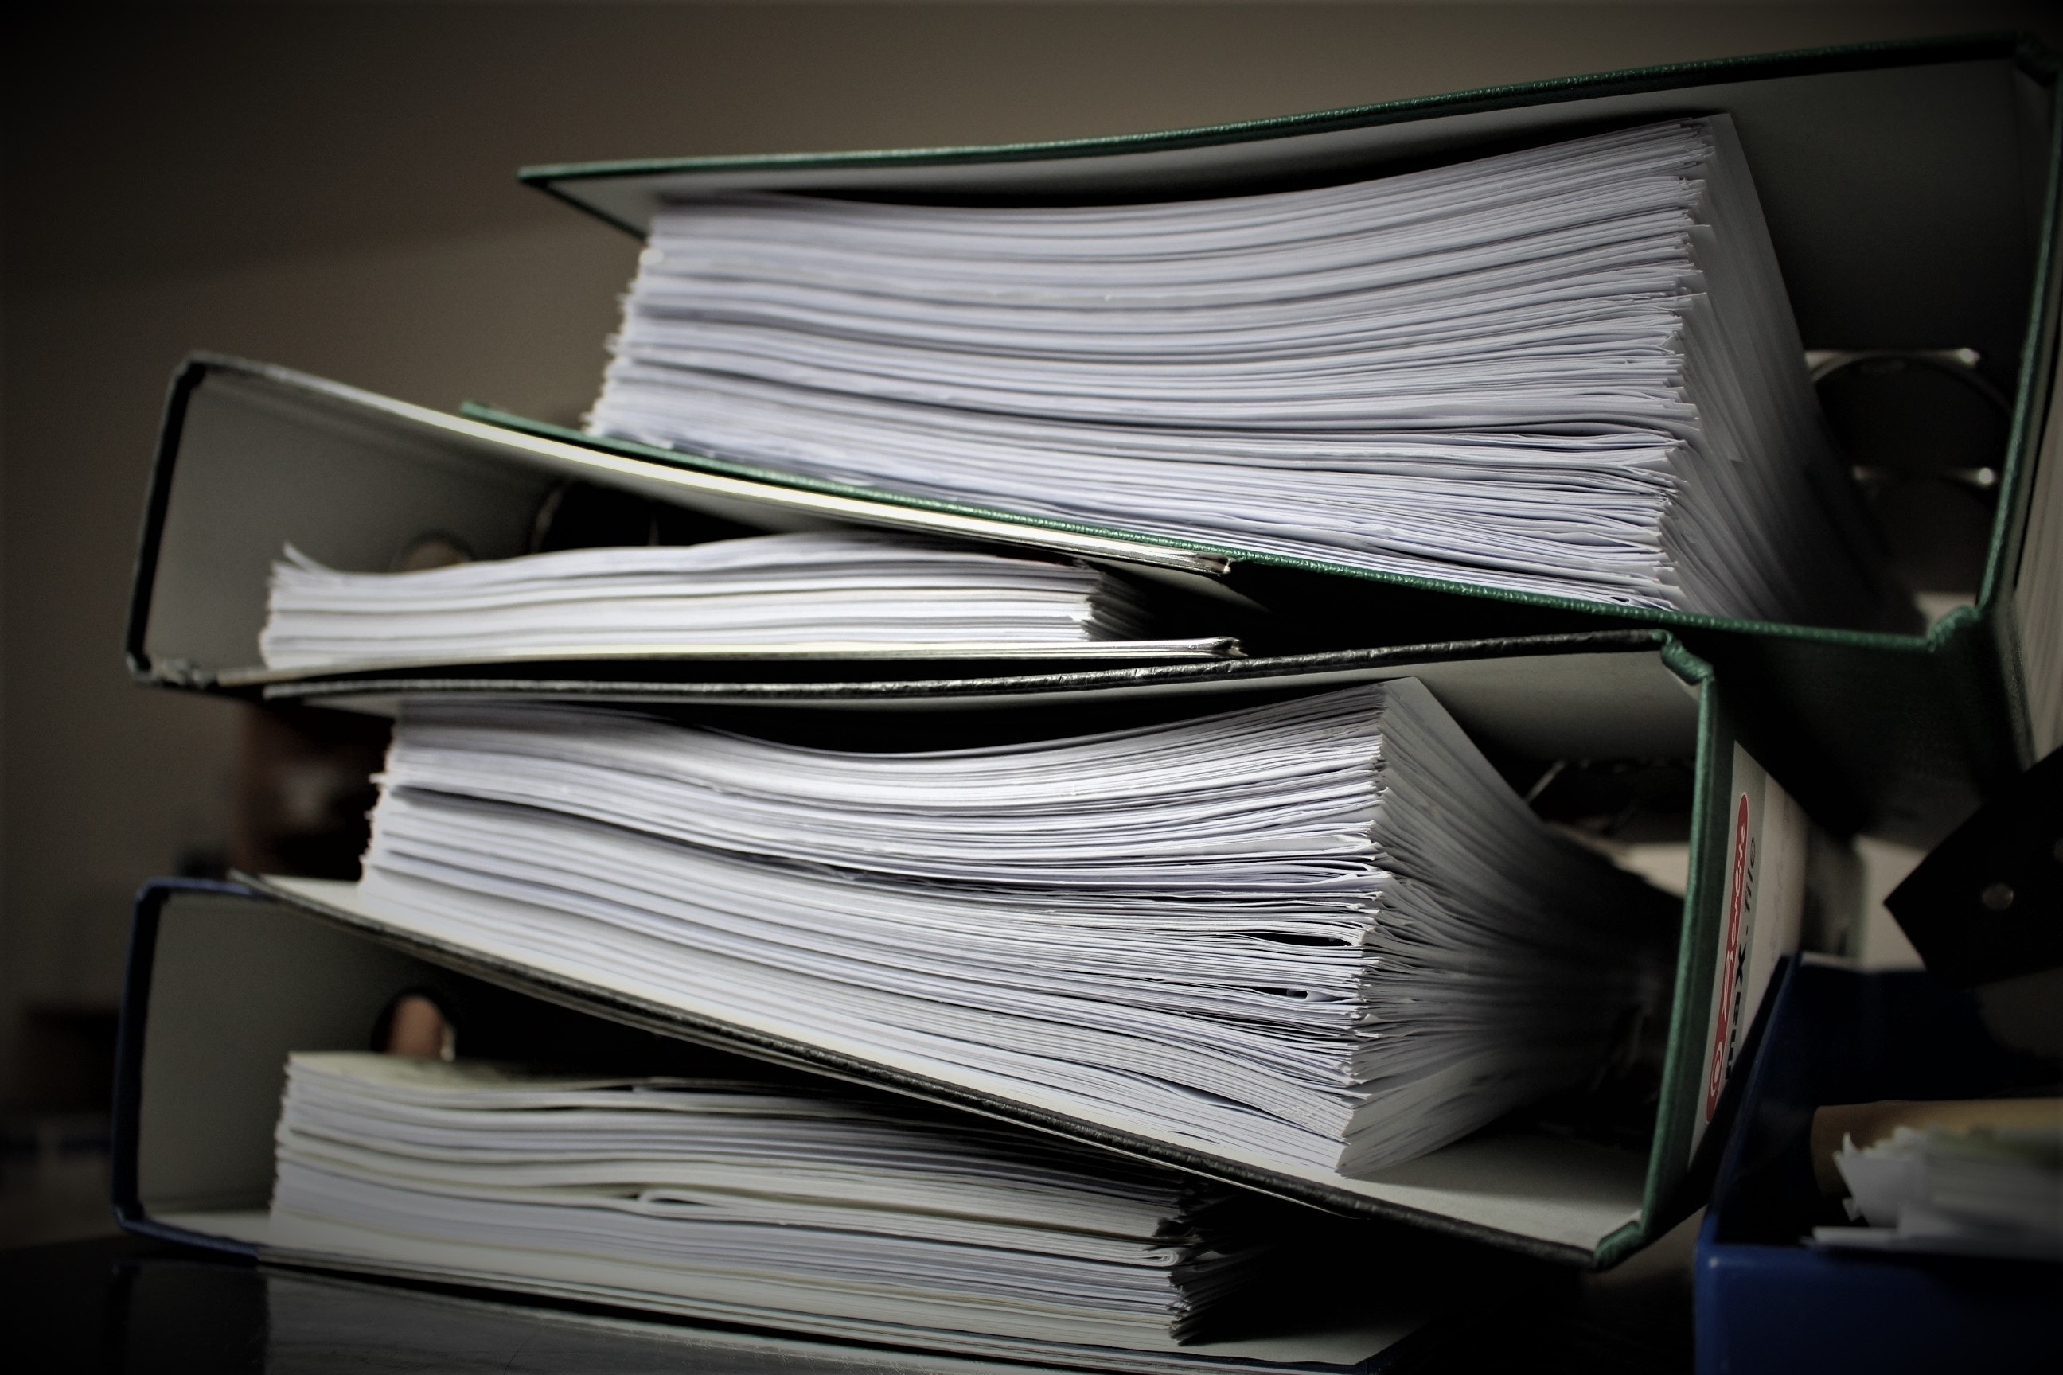
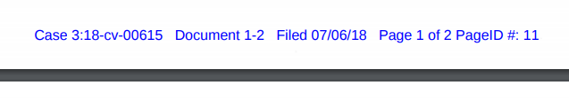
Citing to the Record
First, Look to see if the court has assigned the document an electronic page number.
► Citing to an affidavit
  Last Name Aff. ¶ paragraph number.
  Example: Miller Aff. ¶ 8.
► Citing to an interview
  Last Name Int. at paragraph number.
  Example: Miller Int. at 9.
► Citing to an indictment
  Indict. Count Number.
  Example: Indict. Count 1.
► Citing to an exhibit
  Exh. Exhibit number.
  Example: Exh. 2.
Notes:
Bluebook has common abbreviations for court documents.

Slide 24
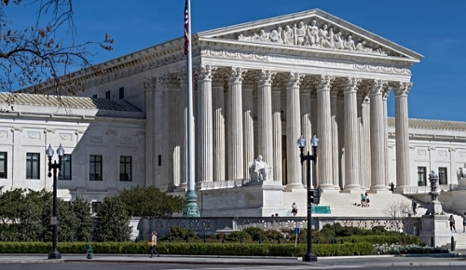
Citing to the Record – Short Form
► Id.
► Id. at ¶ 8.
► Id. at 12.
Make sure that a reader can understand what you are intending to cite.

