Slide 1
OCLRE Moot Court
Webinar 3 –
Mining the Record: Turning a Case File into a Case
Rachel L. Hampton

Slide 2
Agenda
Structure of an Appeal
Mining the Record
Reviewing the Case Law

Slide 3
Structure of an Appeal

Slide 4
Supreme Court
(Court of Last Resort)
Courts of Appeal
(Intermediate Appellate Courts)
Trial Courts (e.g., Courts of Common Pleas)

Slide 5
Appellate Standard of Review
Standard | Level of Deference | Application
De Novo | No deference standard. Referred to as “plenary review” – appellate courts look at legal questions as if no one had yet decided them, giving no deference to legal findings made below. | Reviewing Questions of Law
Clearly Erroneous | High level of deference provided because the fact finder is in the best position to observe the presentation of facts. Only applicable when a review of the record leads to a “definite and firm conviction” that the trial court has made a mistake. | Reviewing Findings of Fact
Abuse of Discretion | Very high level of deference, which presumes the trial court’s expertise. | Reviewing Discretionary Decisions, such as a trial judge’s procedural or evidentiary decisions

Slide 6

Mining the Record

Slide 7




The Record
For an appeal, the record typically includes: the lower court decision(s), the pleadings, the relevant trial court motion papers, and the record evidence submitted to the trial court in support of that motion.
  Note: you cannot add new evidence on appeal; you are bound by the record considered by the lower court.

Slide 8
How to Review the Record
Review the relevant case file. Start with the petition for certiorari order (if applicable) and the lower court decision(s). Then review record materials in chronological order. Take notes as you go.
Brainstorm the main issues, and what research questions you have. Focus on:
  Findings of fact and legal findings in the opinions below, and the page cites
  Positive AND Negative facts, testimony, and other evidence, and the page cites
  Where the various segments of the appendix begin
  Evidence that establishes needed elements of the cause of action, and the page cites
  Major arguments or concessions that each side has made below, and the page cites
  Information that may support any arguments you plan to make, and the page cites
You may need to read the record a few times to understand the significance of each of the documents.

Slide 9
Sample Notes of a Record
Page # | Document | Information | Value / Insight
12 | First page of Trial Court decision (Trial Court decision) | — | —
20 | Trial Court decision | Trial Court’s order regarding the beer signage | This is the relevant portion of the opinion being challenged on appeal. Need to determine standard of review.
25 | First page of deposition of Timothy Ambler, alcohol marketing expert from England (Ambler Dep.) | — | —
30-31 | Ambler Dep. | Testimony regarding mandatory disclosure of alcohol on beer labels in Britain and the European Community | Raises question: Should U.S. follow international precedent?
50 | Plaintiff’s Exhibit 3A | Chart showing alcohol % by weight of various beers | Indicates low variation among most beers
51 | First page of U.S. Dept. of HHS, Inspector General’s Survey on Youth and Alcohol: “Do they know what they’re drinking?” (HHS Survey) | Survey results showing results on youth awareness on alcohol content. | Highlights consumer awareness gaps regarding alcohol content
54 | HHS Survey | Survey findings: “2/3 students can’t distinguish alcoholic beverages from nonalcoholic beverages” | Suggests public health benefit of labeling alcohol percentage

Slide 10
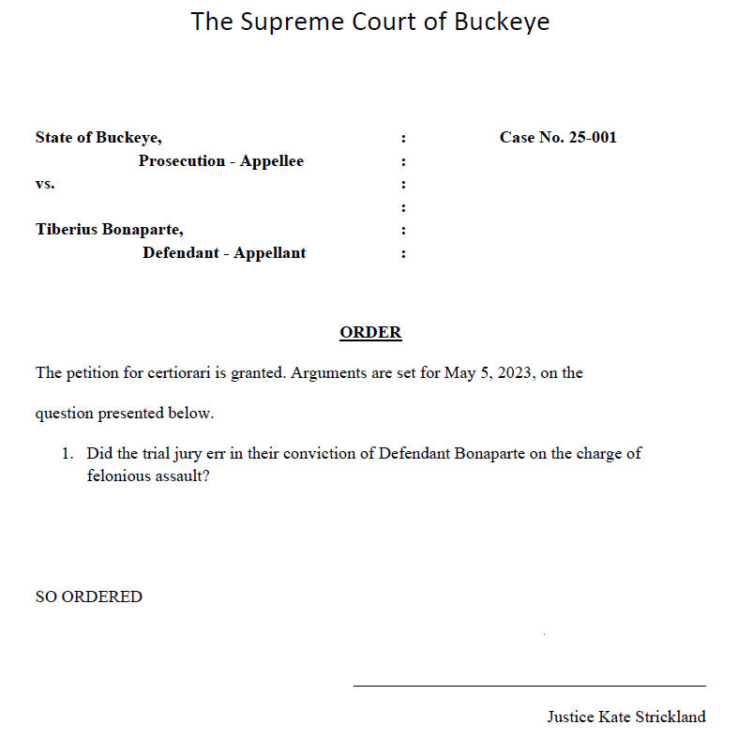
Reviewing the Order on the Petition for Certiorari

Slide 11
Outline/Notes
Did the jury err in convicting Ty for felonious assault?

Slide 12
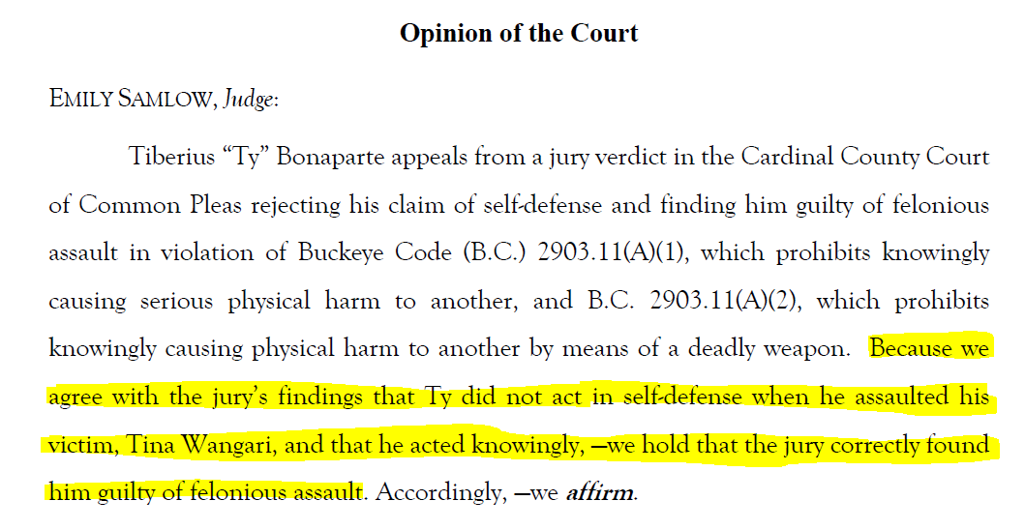
Reviewing the Lower Court Decision
1
2

Slide 13
Outline/Notes
Did the jury err in convicting Ty for felonious assault?
(1) Whether Ty acted in self-defense
(2) Whether Ty acted knowingly

Slide 14
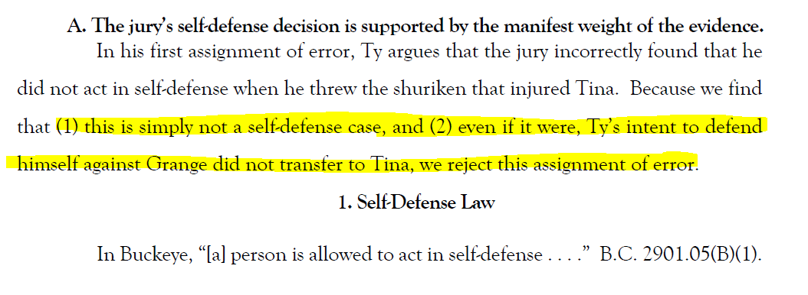
Reviewing the Lower Court Decision

Slide 15
Outline/Notes
Did the jury err in convicting Ty for felonious assault?
(1) Whether Ty acted in self-defense
  (a) is this a self-defense case?
  (b) would Ty’s intent transfer to Tina?
(2) Whether Ty acted knowingly

Slide 16
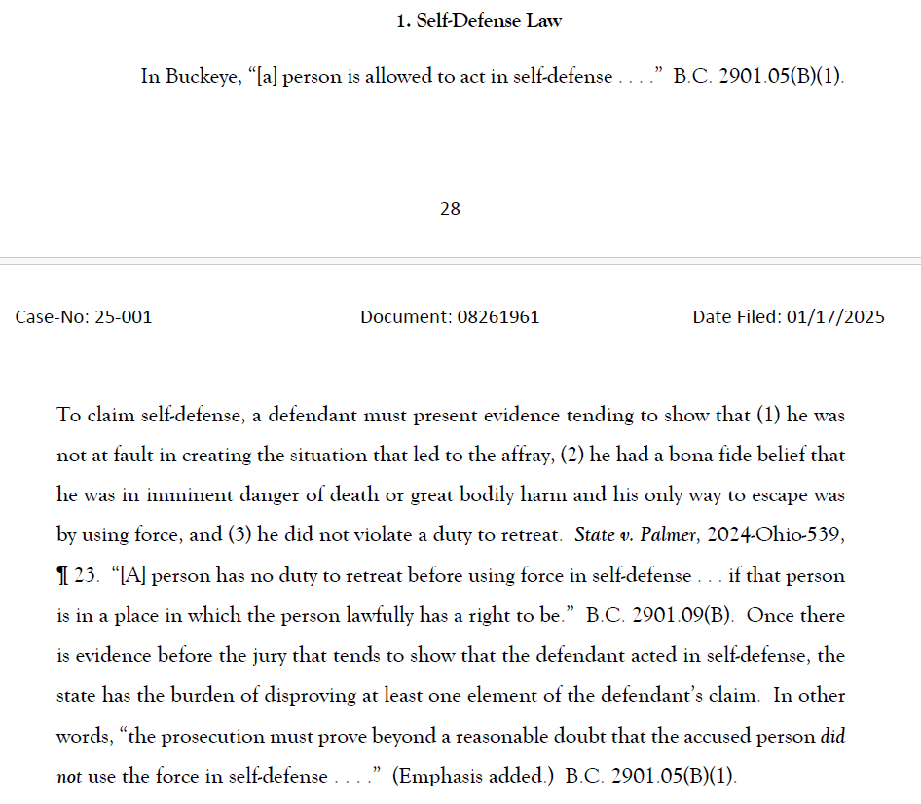
Reviewing the Lower Court Decision

Slide 17
Outline/Notes
Did the jury err in convicting Ty for felonious assault?
(1) Whether Ty acted in self-defense
  (a) is this a self-defense case?
    Law: Is there evidence that Ty (1) was not at fault in creating the situation that led to the affray; (2) he had a bona fide belief he was in imminent danger of death or great bodily harm, and his only way to escape was by using force; and (3) he did not violate a duty to retreat.
  (b) would Ty’s intent transfer to Tina?
(2) Whether Ty acted knowingly

Slide 18
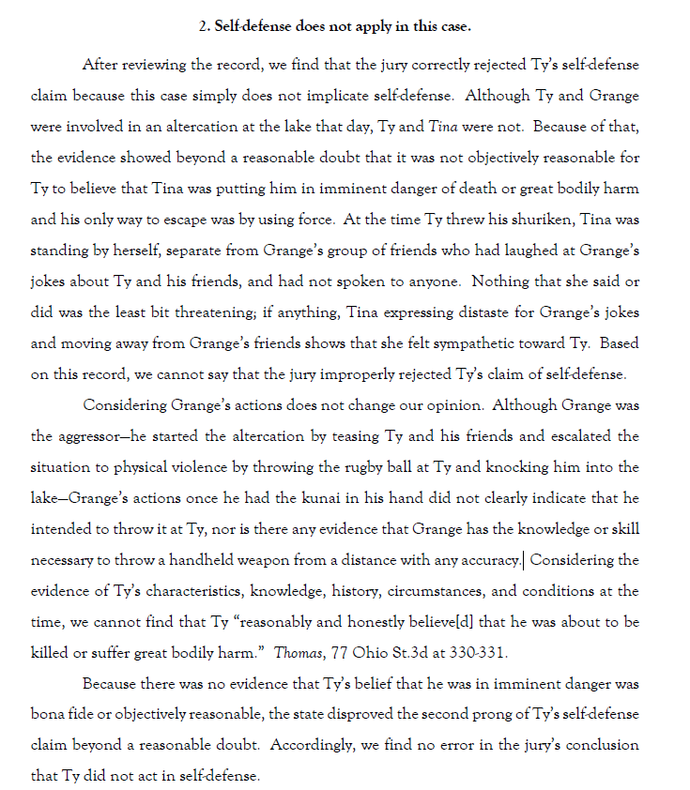
Reviewing the Lower Court Decision

Slide 19
Outline/Notes
Did the jury err in convicting Ty for felonious assault?
(1) Whether Ty acted in self-defense
  (a) is this a self-defense case?
    Law: Is there evidence that Ty (1) was not at fault in creating the situation that led to the affray; (2) he had a bona fide belief he was in imminent danger of death or great bodily harm, and his only way to escape was by using force; and (3) he did not violate a duty to retreat.
    Facts:
      Lower court said no self-defense because Ty and Tina were not in an altercation.
      Lower court said no evidence of belief by Ty of imminent danger from Grange.
      … [cont.]
  (b) would Ty’s intent transfer to Tina?
(2) Whether Ty acted knowingly

Slide 20
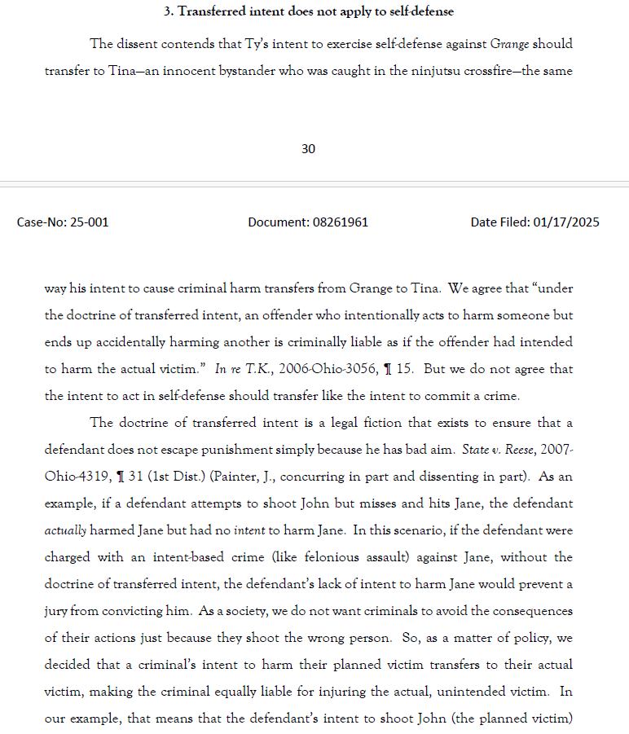
Reviewing the Lower Court Decision

Slide 21
Outline/Notes
Did the jury err in convicting Ty for felonious assault?
(1) Whether Ty acted in self-defense
  (a) is this a self-defense case?
    Law: Is there evidence that Ty (1) was not at fault in creating the situation that led to the affray; (2) he had a bona fide belief he was in imminent danger of death or great bodily harm, and his only way to escape was by using force; and (3) he did not violate a duty to retreat.
    Facts:
      Lower court said no self-defense because Ty and Tina not in an altercation.
      Lower court said no evidence of belief by Ty of imminent danger from Grange.
  (b) would Ty’s intent transfer to Tina?
    Law: Lower court says intent to act in self-defense cannot be transferred (unlike intent to commit a crime)
(2) Whether Ty acted knowingly

Slide 22
Reviewing the Case Law

Slide 23
Research Tips
Start with the cases cited by the lower courts if you can.
Look at your facts as you look at the cases. Research is recursive so you might not realize what facts are legally significant until after you do some research.
Keep in mind:
  The hierarchy of authority and mandatory v. persuasive case law. Supreme courts prefer their own cases.
  That you might use case law in different (or multiple) ways. E.g.., for a rule or explanation of a rule, for application of a rule (and therefore for factual analogy to your case), for helpful dicta, etc.
Keep a log or notes as you go.

Slide 24
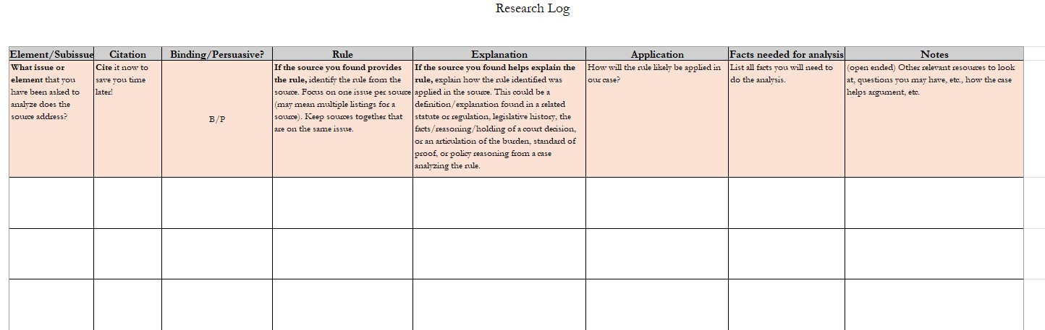
Sample Research Log

Slide 25
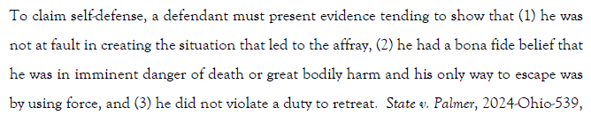
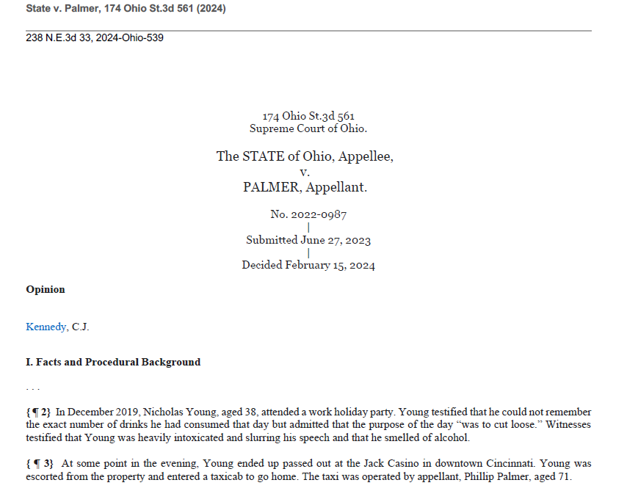
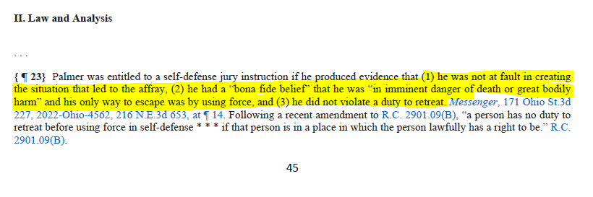
Reviewing Cases

Slide 26
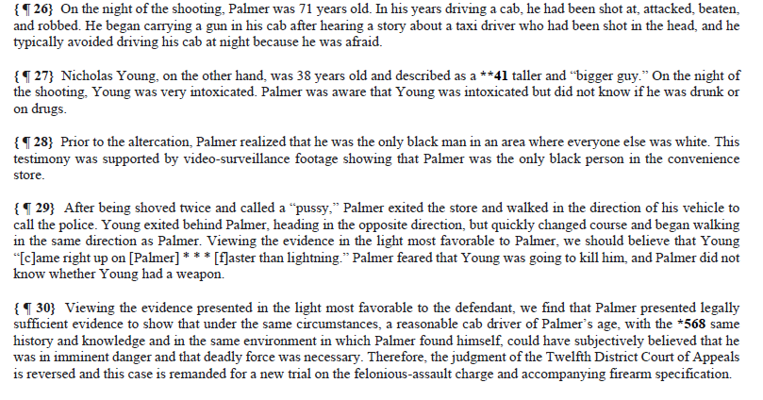
Reviewing Cases, Cont.

Slide 27
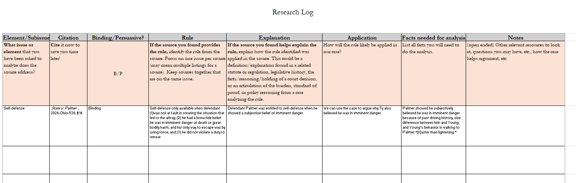
Sample Research Log

Slide 28
Outline/Notes
Did the jury err in convicting Ty for felonious assault?
(1) Whether Ty acted in self-defense
  (a) is this a self-defense case
    Law: Is there evidence that Ty (1) was not at fault in creating the situation that led to the affray; (2) he had a bona fide belief he was in imminent danger of death or great bodily harm, and his only way to escape was by using force; and (3) he did not violate a duty to retreat. State v. Palmer, 2024-Ohio-539, ¶ 14.
    Palmer showed he subjectively believed he was in imminent danger because of past driving history, size difference between him and Young, and Young’s behavior in walking to Palmer “[f]aster than lightening.” Palmer, 2024-Ohio-539, ¶ 26-30.
    Facts:
      Lower court said no self-defense because Ty and Tina not in an altercation.
      Lower court said no evidence of belief by Ty of imminent danger from Grange. Are there facts in Palmer that look like or unlike our case? What about size of Ty as compared to Grange, as well as Grange’s behavior?
  (b) would Ty’s intent transfer to Tina?
    Law: Lower court says intent to act in self-defense cannot be transferred (unlike intent to commit a crime)
(2) Whether Ty acted knowingly

Slide 29
Conclusion

